Slide 1

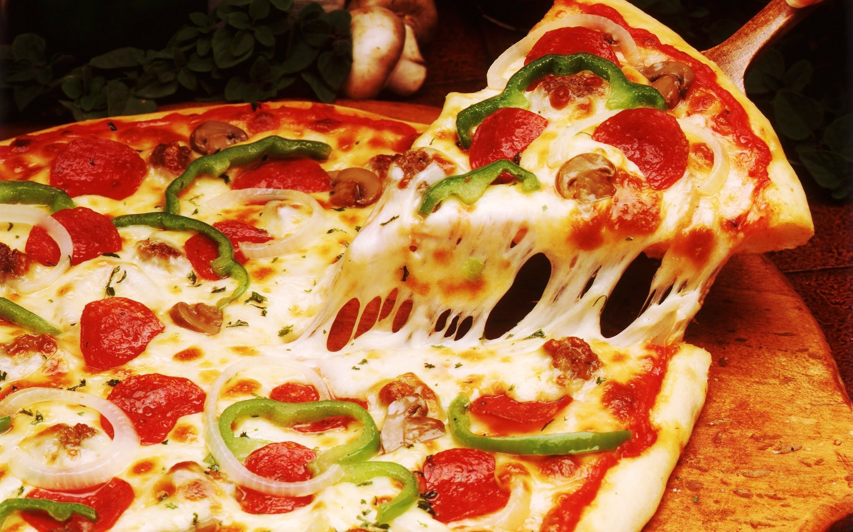

Pizza Sales

Slide 2

Total revenue
Total revenue was generated from sum of the total prices of all pizza orders
817.86K

Slide 3
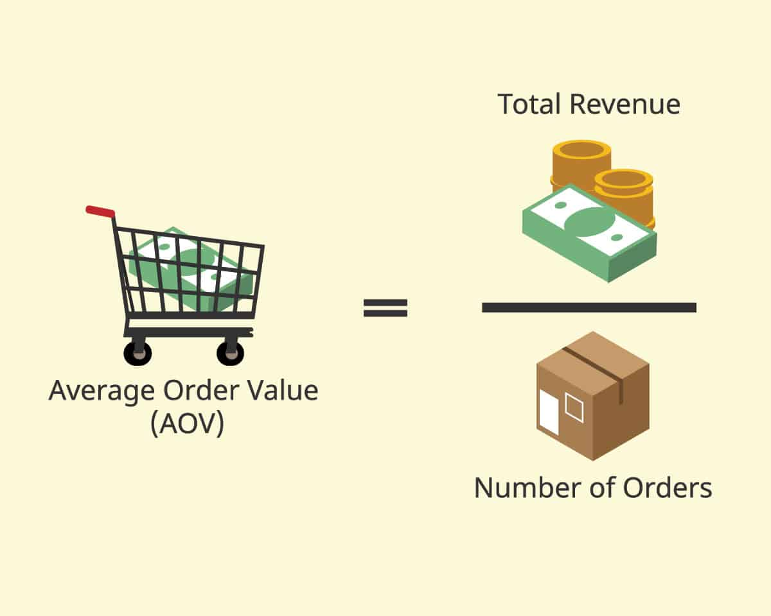
Average Order Value
38.31

Slide 4

Total Pizza’s Sold
Sum of the quantities of all pizzas sold
49574

Slide 5

Total Order’s
Total number of orders placed
21.35K

Slide 6
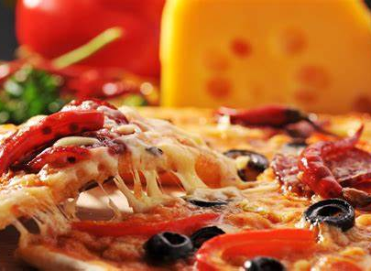
Average Pizza Order
It is calculated by dividing the total number of pizzas sold by total number of orders
2.32

Slide 7
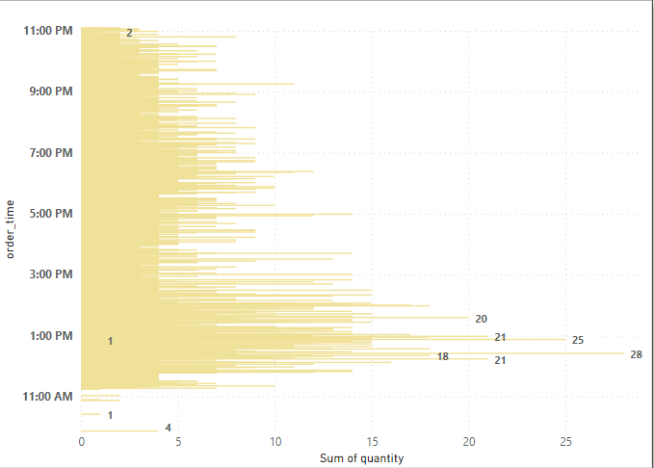
DAILY TREND FOR TOTAL ORDERS
A bar chart that displays the daily trend of total orders over a specific time period.
This chart will help us identity any patterns or fluctuations in order volumes on a daily basis
From the chart
785 orders placed on Day 7
736 orders placed on Day 1
729 orders placed at Day 5

Slide 8
MONTHLY TREND FOR TOTAL ORDERS
A line chart that indicates the hourly trend of total orders throughout the day
This chart will allow you to identify peak hours or periods of high order activity
From the Graph
4392 pizzas placed in July
4328 pizzas placed in May
4392 pizzas placed in March

Slide 9
PERCENTAGE OF SALES BY PIZZA CATEGORY
A pie chart that shows the distribution of sales across different pizza categories.
This chart will provide insights into the popularity of various pizza categories and their contribution to overall sales
From the pie-chart
Classic category mostly ordered of 208K i.e (25.2%)
Supreme category mostly ordered of 208K i.e (25.2%)
Chicken category mostly ordered of 208K i.e (25.2%)
Veggie category mostly ordered of 208K i.e (25.2%)

Slide 10
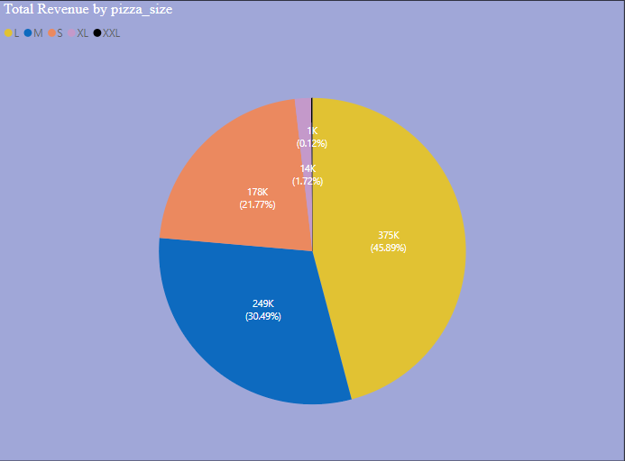
PERCENTAGE OF SALES BY PIZZA SIZE
A pie chart that represents the percentage of sales attributed to different pizza sizes.
This chart will help us to understand customer preference for pizza sizes and their impact on sales
From the pie-chart
L size pizzas are mostly ordered in 375K i.e (45.89%)
M size pizzas are mostly ordered in 375K i.e (45.89%)
S size pizzas are mostly ordered in 375K i.e (45.89%)
XL size pizzas are mostly ordered in 375K i.e (45.89%)
XXL size pizzas are mostly ordered in 375K i.e (45.89%)

Slide 11
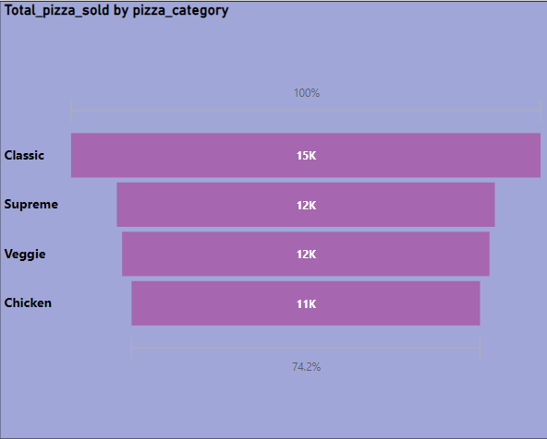
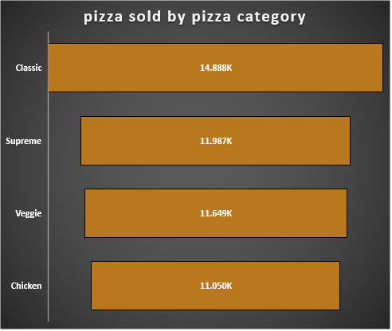
TOTAL PIZZA SOLD BY PIZZA CATEGORY
A funnel chart that presents the total number of pizzas sold for each pizza category.
This Chart will allow you to compare the sales performance of different pizza categories
From the Funnel chart
15K were sold in Classic category
12K were sold in Supreme category
12K were sold in Veggie category
11K were sold in Chicken category

Slide 12
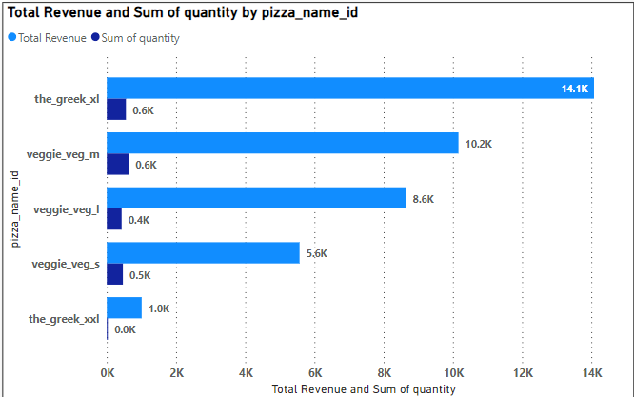
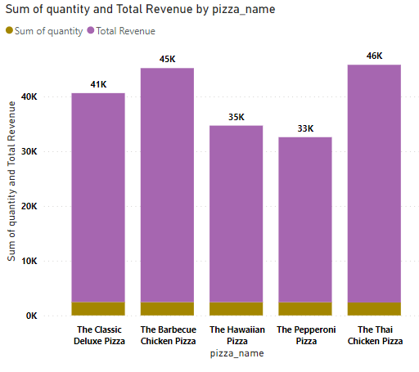
TOP 5 BEST SELLERS BY REVENUE,TOTAL QUANTITY AND TOTAL ORDERS
A Bar chart highlighting the top 5 best selling pizzas based on the revenue , total quantity, total orders.
This chart will allow you to identify the most popular pizza options
From the graph
2432 of The Barbeque chicken pizza as value of 42.76K
2370 of The California chicken pizza as value of 41.41K
2453 of The Classic deluxe pizza as value of 38.18K
1924 of The Spicy Italian pizza as value of 34831
2371 of The Thai chicken pizza as value of 43.43K

Slide 13
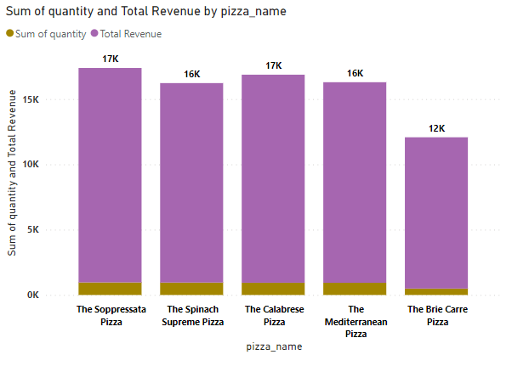
TOP 5 WORST SELLERS BY REVENUE,TOTAL QUANTITY AND TOTAL ORDERS
A Bar chart highlighting the top 5 best selling pizzas based on the revenue , total quantity, total orders.
This chart will allow you to identify the most popular pizza options
From the graph
490 pizzas named The Brie carre pizzaa value of 11.58K
997 pizzas named The Garden Pizza as value of 13.95K
934 pizzas named The mediterrinean pizza as value of 15.36K
970 pizzas named The Spinach pasta pizza as value of 15.59K
950 pizzas named The Spinach Supreme pizza as value of 15.27K

Slide 14


